Slide 1




Cassandra
an open source NoSQL distributed database
Team members:
Sofia 狄苏菲
Kristina 伯汀娜
Viacheslav 维亚
Assyl 丝 儿
Aleksey 流沙

Slide 2

OUTLINE
Part 1:
What is Column DB?
Advantages and Disadvantages of Column DB
Introduction to Apache Cassandra
Features of Cassandra
Advantages and Disadvantages of Cassandra
Use Cases
Mind Map
Part 2:
Hands-On: Installing Cassandra via Docker Desktop
Hands-On: Using Cassandra (Functions & Queries)
Experiment

Slide 3
PART 1
Theory

Slide 4




Column DB
Column databases store data in columns, which differs from traditional relational databases with row-based storage. It allows for efficient processing of queries involving specific columns rather than rows. This facilitates effective use of data compression methods and speeds up data retrieval. Column DB were influenced by Bigtable.

Slide 5
How it works
Column Family — This is a group of related columns, such as all the user’s information: name, age, settings, etc.
Column — Each column stores a piece of data, like Name: John or Age: 30. Different rows can have different columns.
Timestamp — Every piece of data has a timestamp that shows when it was last updated. It helps the system know which version of the data is the most recent.
Row Key — This is like a name for a set of data about one object . For example, a row of data for a user could have the key user123.

Slide 6
Example:
Imagine a table of students with columns for names, ages, and grades:
In a row-oriented database, each student’s information is stored in one row.
In a columnar database, all names are stored in one place, all ages in another, and all grades in yet another.
How it works:
Writing: Data is saved under the row key into the appropriate column family.
Reading: Data is retrieved using the row key and the latest versions (based on the timestamp) of each column are returned.

Slide 7
How it works
Colomn Family0 | Colomn Family0 | Colomn Family0 | Colomn Family0 | Colomn Family0
Colomn 0 | Colomn 0 | Colomn 0 | C1 | C2
Row ID | Value | TimeStamp

Slide 8

Advantages of Column DB
Faster Query Performance for Analytical Workloads:
Optimized for handling queries that require data retrieval from multiple columns, which speeds up aggregation and selection.
In columnar databases, only the relevant columns needed for a query are read from disk, while traditional row-based databases (like MySQL or PostgreSQL) must read entire rows, including irrelevant data. This minimizes disk I/O and significantly improves query performance, especially in analytical workloads where queries often aggregate data (e.g., SUM, AVG, etc.) across many rows but only involve a few columns.

Slide 9
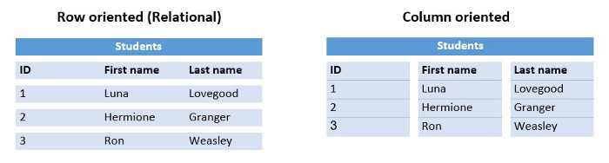

Advantages of Column DB
Faster Query Performance for Analytical Workloads:
Check every row and get data
Take one column data as a whole

Slide 10
Advantages of Column DB
Effective Data Compression:
Data in a single column has a similar structure, which allows for the application of efficient compression methods.
Data within a single column tends to be more homogeneous (e.g., storing only integers or dates), allowing for more effective compression algorithms. This reduces the overall storage space required.
integer
string/text
string/text

Slide 11


Disadvantages of Column DB
Write Performance:
Columnar databases are optimized for read-heavy operations, making them less efficient for write-heavy workloads. This is because writing data to a columnar database often involves more overhead compared to row-oriented databases, which can lead to slower insert and update operations. In scenarios where frequent updates or real-time data ingestion are required, a columnar database may not perform optimally.

Slide 12
Disadvantages of Column DB
Complex Queries:
While columnar databases excel at analytical queries that aggregate large volumes of data, they can struggle with complex queries involving multiple joins, especially when the data is stored in multiple columns. The way data is structured can lead to inefficient query execution plans, increasing response times for certain types of queries compared to traditional relational databases.
Limited Transaction Support:
Many columnar databases are not designed for transactional workloads that require ACID (Atomicity, Consistency, Isolation, Durability) compliance. This can be a significant limitation for applications that need to perform frequent transactions, as the eventual consistency model used by some columnar databases may not guarantee data integrity in real-time.

Slide 13
What is Apache Cassandra?
Cassandra is a NoSQL distributed column database. Since it is a distributed database, Cassandra can have multiple nodes. A node represents a single instance of Cassandra.
These nodes communicate with one another through a protocol called gossip, which is a process of computer peer-to-peer communication. Multiple nodes can be organized logically into a cluster, or "ring".

Slide 14
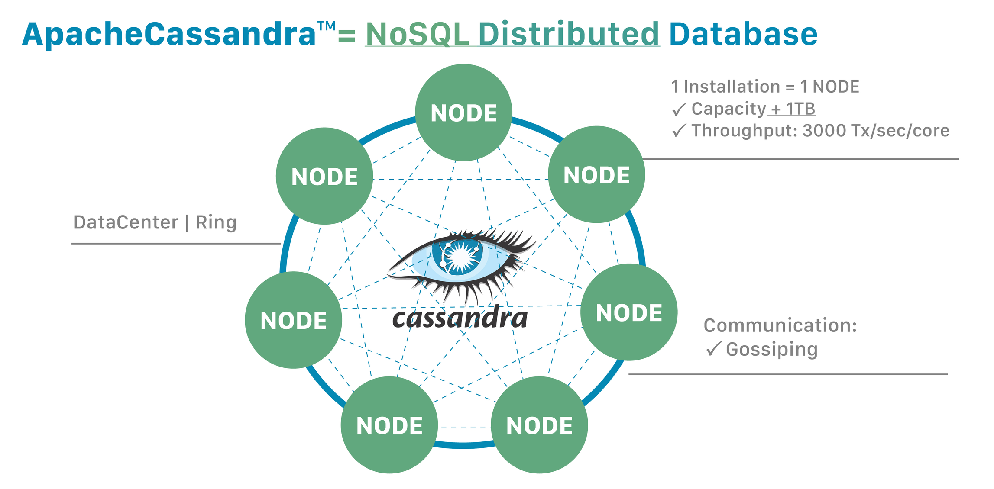

Slide 15







Key features
Distributed Architecture
Scalability
Partition
Fault Tolerance
Tunable Consistency

Slide 16


Distribution
"Distributed" means that Cassandra can run on multiple machines while appearing to users as a unified whole. So, to get the maximum benefit out of Cassandra, you would run it on multiple machines.

Slide 17
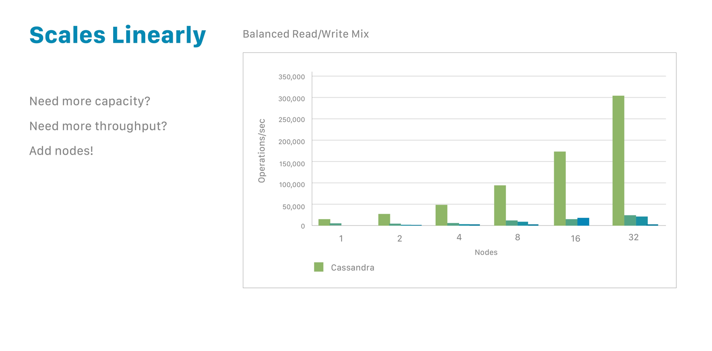
Scalability
Because it’s based on nodes, Cassandra scales horizontally (aka scale-out), using lower commodity hardware. To double your capacity or double your throughput, double the number of nodes. That’s all it takes.

Slide 18
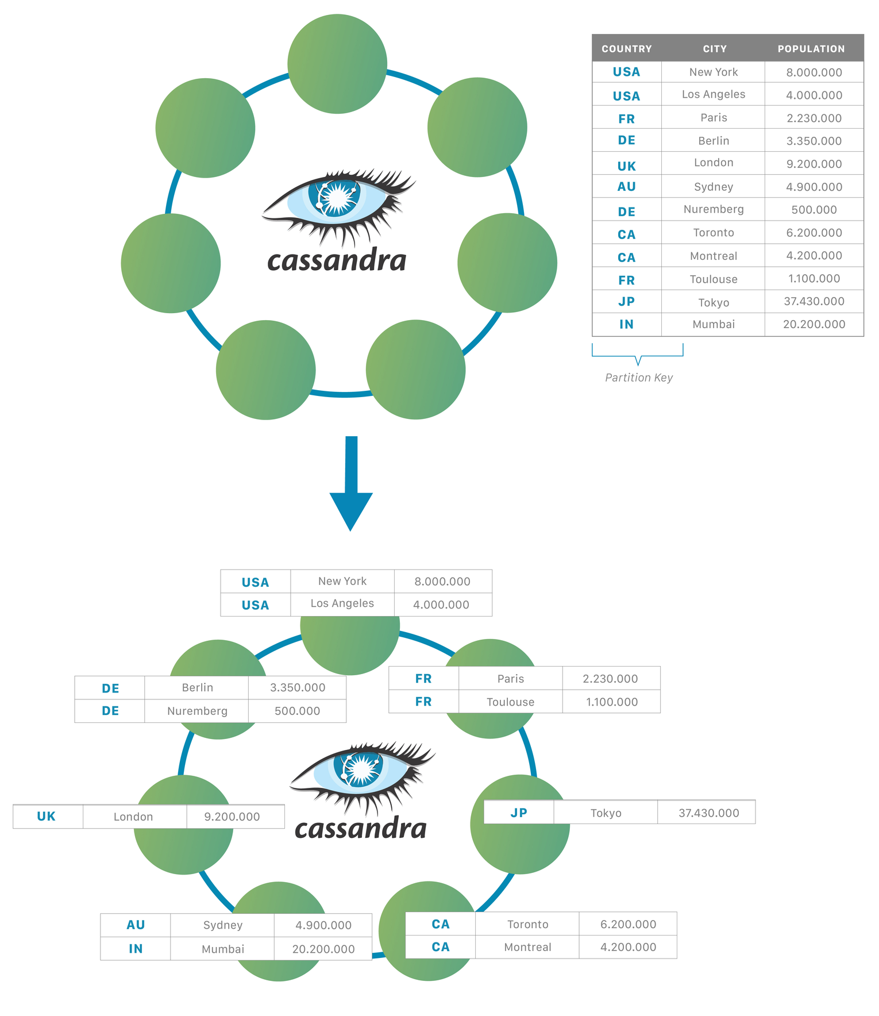
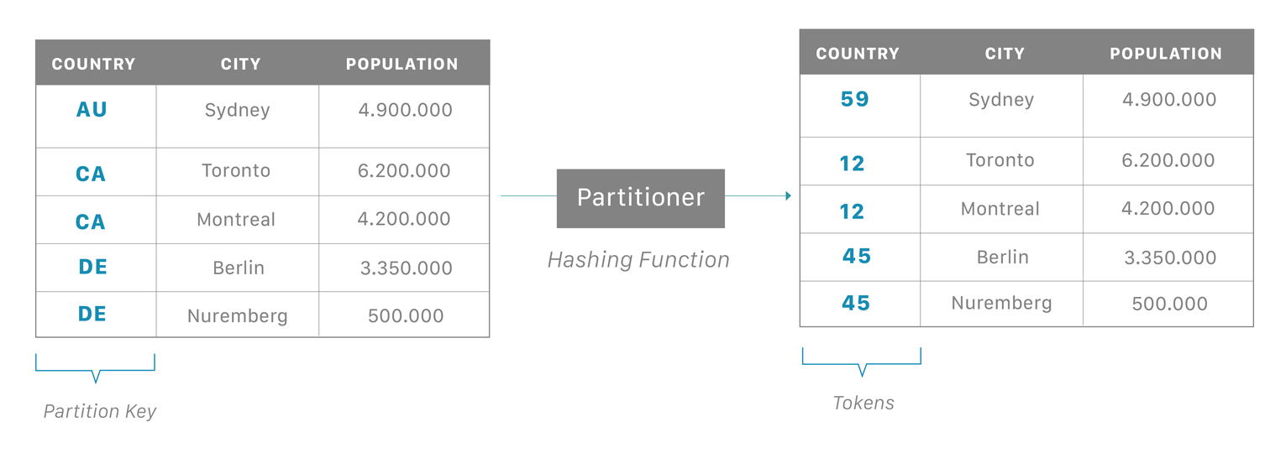
Partition
The partition key is responsible for distributing data among nodes and is important for determining data locality.

Slide 19
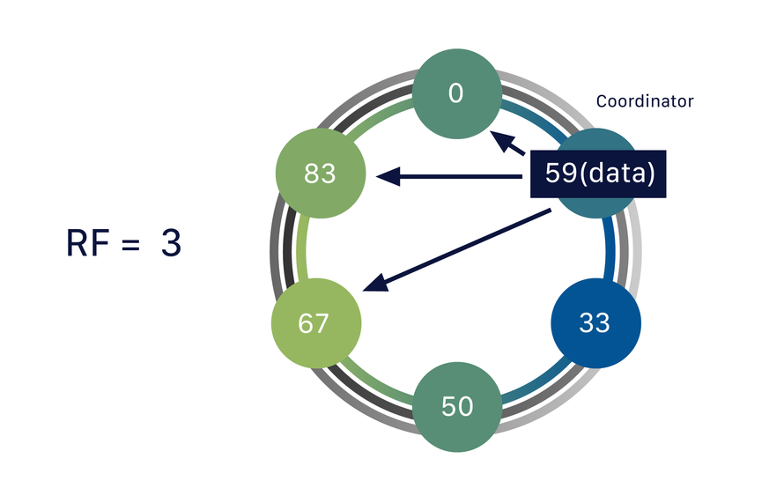
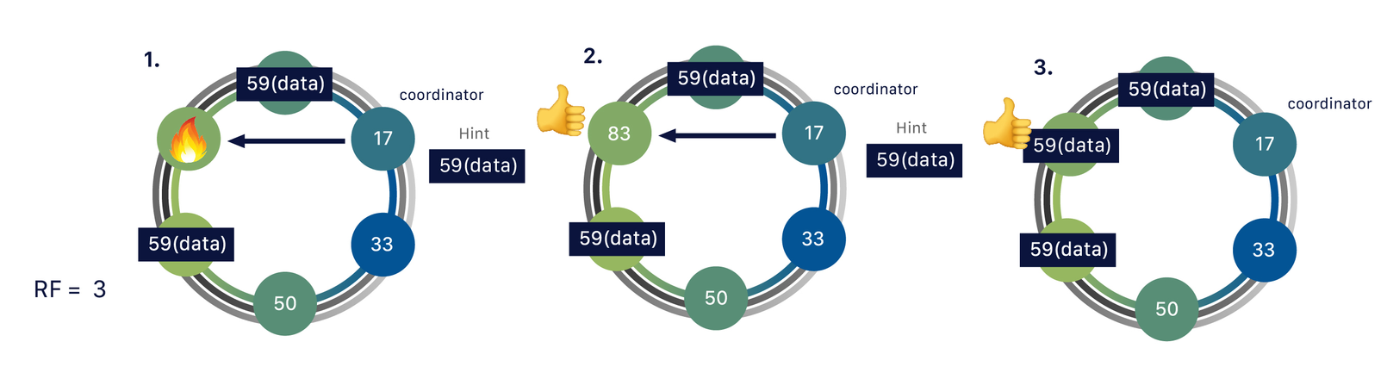
Fault Tolerance
One piece of data can be replicated to multiple (replica) nodes, ensuring reliability and fault tolerance. Doing so helps the system to be self-healing if something goes wrong.

Slide 20
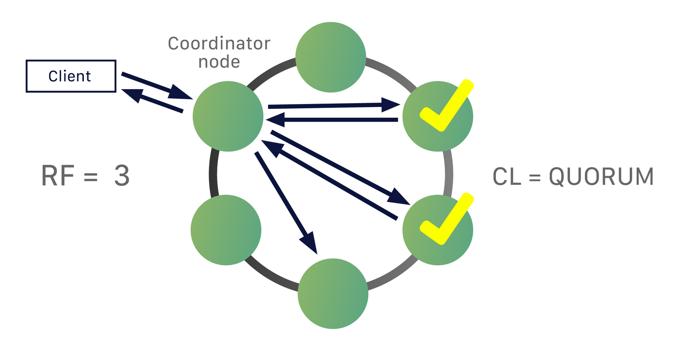
Tuning consistency
The consistency level represents the minimum number of Cassandra nodes that must acknowledge a read or write operation to the coordinator before the operation is considered successful. We have a CL=QUORUM (Quorum referring to majority RF/2 +1).

Slide 21

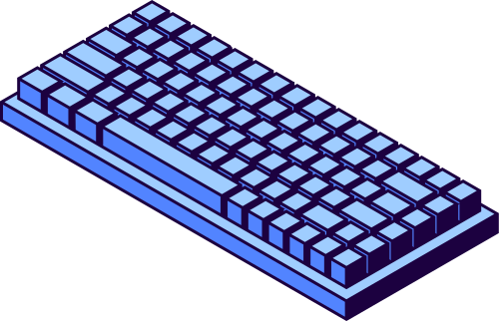
Advantages
read repair
hinted handoff
a flexible data scheme based on a combination of column families
proprietary SQL-like query language

Slide 22
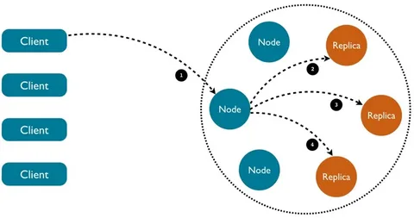
Read repair
In Cassandra, data is replicated across multiple nodes to provide fault tolerance. During read operations, Cassandra performs a read repair where inconsistencies in replicas are detected and corrected. If data is found to be out of sync, Cassandra automatically repairs the outdated replicas in the background. This ensures consistency across all replicas without requiring manual intervention.

Slide 23
Hinted handoff
Hinted handoff is a mechanism to ensure data availability even when a node is temporarily down. When a write is attempted and a node is unavailable, Cassandra stores the write request (hint) on a nearby node. Once the downed node comes back online, the hinted data is sent to it to catch up with the rest of the cluster. This process minimizes data loss and keeps the system resilient in the face of temporary failures.

Slide 24
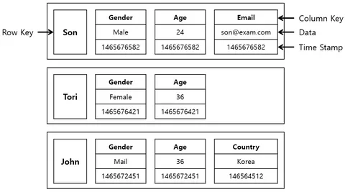
Flexible data scheme
Cassandra employs a flexible, schema-optional model based on column families rather than traditional rows and columns. Each column family is essentially a table, but unlike fixed schemas in relational databases, you can store different sets of columns for different rows. This flexibility allows Cassandra to handle structured, semi-structured, and unstructured data efficiently. Developers can easily adapt their data model to evolving business needs without downtime.

Slide 25
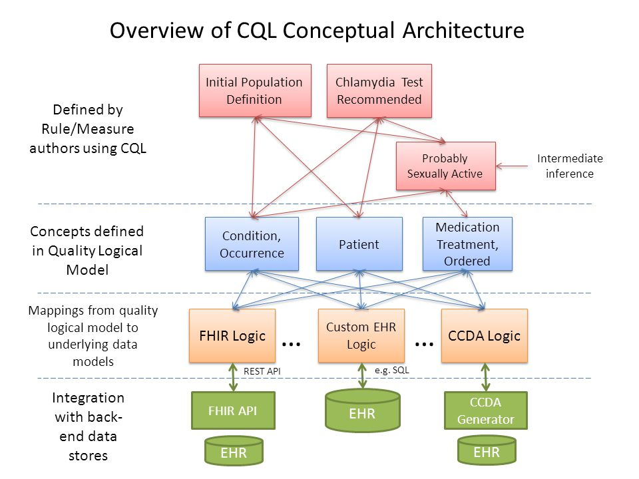
Proprietary SQL-like query language
Cassandra offers Cassandra Query Language (CQL), a proprietary SQL-like language designed specifically for interacting with its data model. CQL provides a familiar interface for developers used to working with SQL, allowing them to manage data with commands similar to SQL queries. Although similar, CQL differs by being optimized for Cassandra’s distributed nature, ensuring efficient querying and data management across large-scale clusters. It simplifies working with Cassandra while leveraging its distributed, NoSQL capabilities.

Slide 26

Disadvantages
Does not support join operations
High overheads
Key uniqueness
Diffifculties with search operations
Difficulties with counter data type

Slide 27
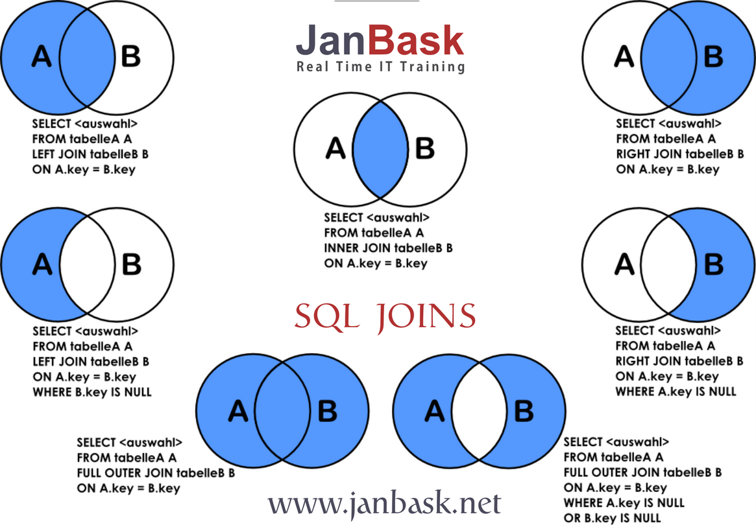
Does not support join operations
In Cassandra, tables are designed for specific query patterns and do not support complex SQL-like JOIN operations. A JOIN in a traditional relational database allows data from multiple tables to be combined based on a related column. Cassandra, being a NoSQL database, follows a denormalized data model, meaning data is often duplicated across tables to avoid the need for JOINS. This simplifies read operations but increases the complexity of data management and design.

Slide 28


High overheads
Key uniqueness
Cassandra’s architecture is distributed, which involves replicating data across multiple nodes to ensure fault tolerance and availability. However, this replication comes with high resource costs, such as storage, memory, and network bandwidth. Managing multiple copies of data across nodes can increase write amplification and resource utilization.
Cassandra enforces a unique primary key for each record, which consists of the partition key and optional clustering columns. While this design is intended to ensure quick retrieval of data, it can complicate data modeling when there is a need for composite or non-unique key constraints, which are common in relational databases.

Slide 29
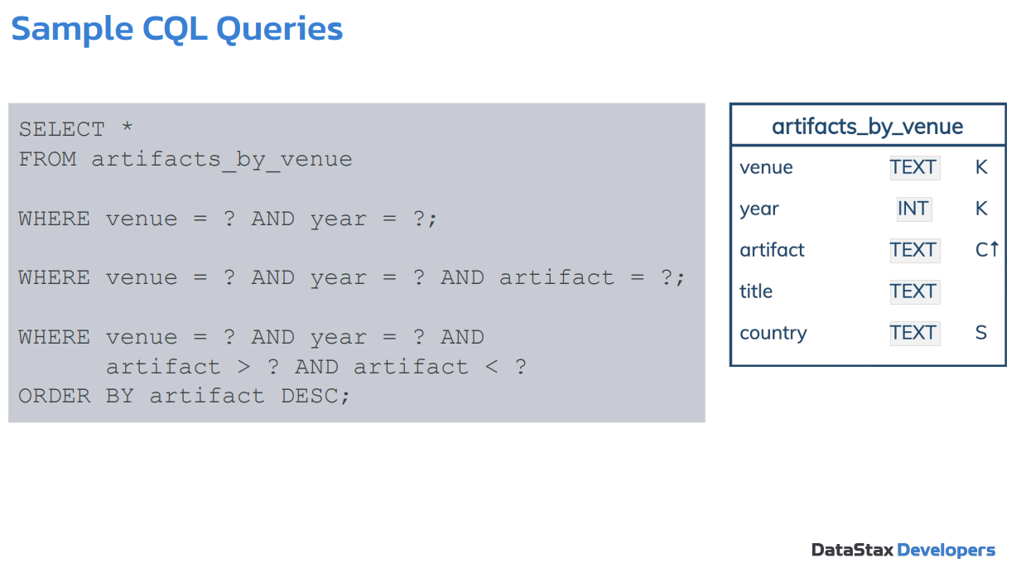
Diffifculties with search operations
Cassandra is optimized for quick reads and writes by key lookups, but it lacks built-in support for complex search operations such as full-text search or range queries. These features are often expected in traditional databases or systems. Cassandra queries must be planned carefully around the partition key, which limits flexibility in performing searches across large datasets.

Slide 30
Difficulties with counter data type
Cassandra provides a special data type called a counter to support atomic increments or decrements. However, counters in Cassandra can be tricky to work with due to limitations such as strict conditions for updates. For example, they can't be part of a batch update with other columns, and concurrent updates to counters can sometimes cause consistency issues without careful configuration.

Slide 31




Use Cases
Real-Time Big Data Analytics:
Cassandra’s architecture is designed for handling large amounts of data across distributed systems, making it well-suited for real-time big data analytics. With its ability to perform fast reads and writes, Cassandra enables companies to analyze massive datasets in real time. Data is distributed across multiple nodes, ensuring that analytics workloads can be processed in parallel. This is particularly useful for businesses that need to analyze customer behavior, network traffic, or any other high-volume data in real time.
Example: A social media platform analyzing user interactions in real time to optimize content delivery and engagement metrics.
Internet of Things (IoT) Applications:
Cassandra is ideal for IoT applications due to its ability to handle high-velocity data streams and scale horizontally as device numbers grow. Its eventual consistency model suits IoT, where data is collected across multiple locations and synchronized over time.
Example: Cisco uses Cassandra to power its IoT infrastructure for monitoring devices and collecting telemetry data from connected devices across different environments.

Slide 32


Use Cases
Time-Series Data Storage:
Cassandra excels at time-series data storage, efficiently handling large volumes of sequential data like logs, sensor readings, or financial records. Its partitioning strategy distributes data across nodes for high availability and fault tolerance.
Example: Uber relies on Cassandra for its mission-critical data, such as real-time ride-tracking, trip details, and dynamic pricing.
High-Velocity Write Operations:
Cassandra is optimized for high write throughput, making it ideal for scenarios where there is a need to ingest vast amounts of data at high speeds. Its write-first approach and log-structured storage engine (LSM) ensure that writes are highly performant, even under heavy load. This makes Cassandra suitable for applications that generate massive amounts of write-heavy workloads.
Example: A global e-commerce platform processing millions of transactions per second, where high-speed writes are crucial to record purchases, orders, and user interactions in real time.

Slide 33


Use Cases
Global, Distributed Applications:
Cassandra’s peer-to-peer architecture is ideal for global applications, enabling data replication across multiple data centers for low-latency access. Its tunable consistency model lets developers balance consistency, availability, and partition tolerance.
Example: A global social network using Cassandra to store user data for fast access worldwide.
Personalization and Recommendation Engines:
Cassandra's fast data retrieval and storage make it ideal for personalization and recommendation engines. Its distributed architecture efficiently processes large datasets of user behavior, enabling real-time, tailored content, product, or service recommendations based on user preferences.
Example: A video streaming service using Cassandra to store user watch histories and preferences, enabling it to provide real-time recommendations for content based on past viewing habits.

Slide 34
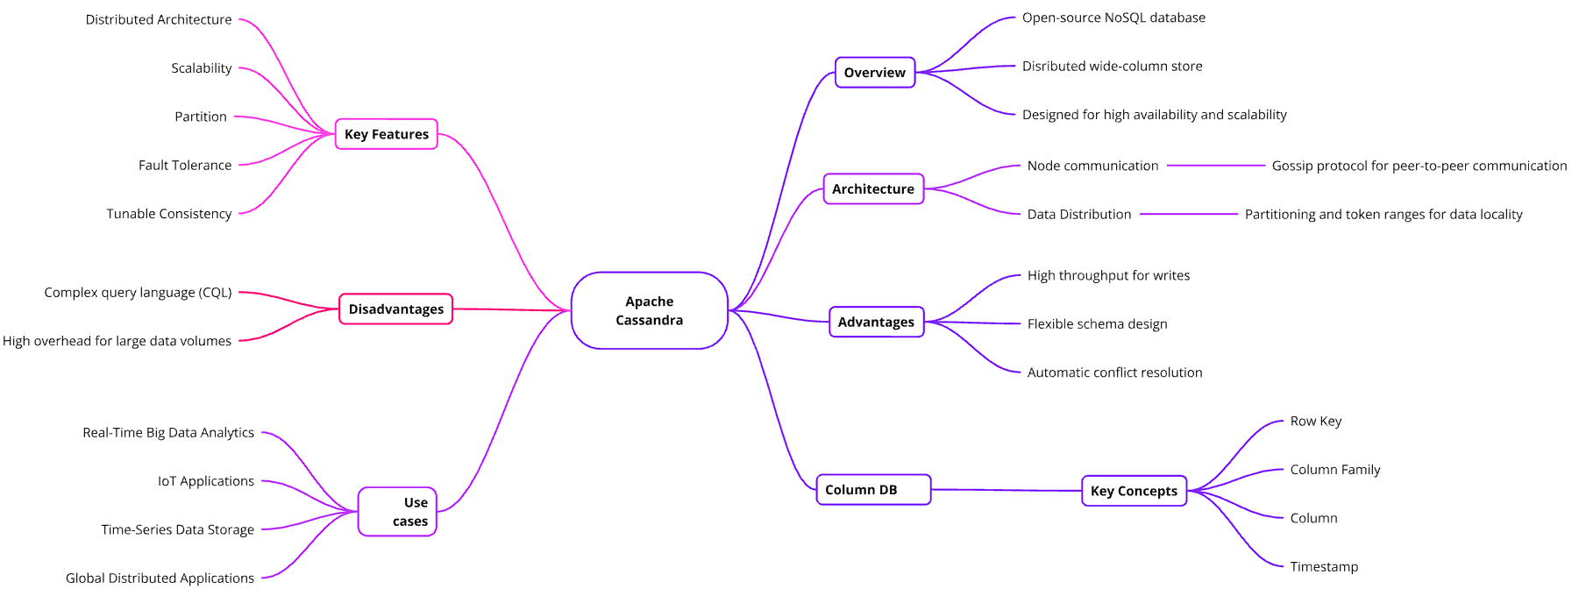
Mind Map

Slide 35

Quiz

Slide 36
PART 2
Experiment and Usage

Slide 37

Installing using Docker Desktop
https://www.docker.com/products/docker-desktop/

Slide 38
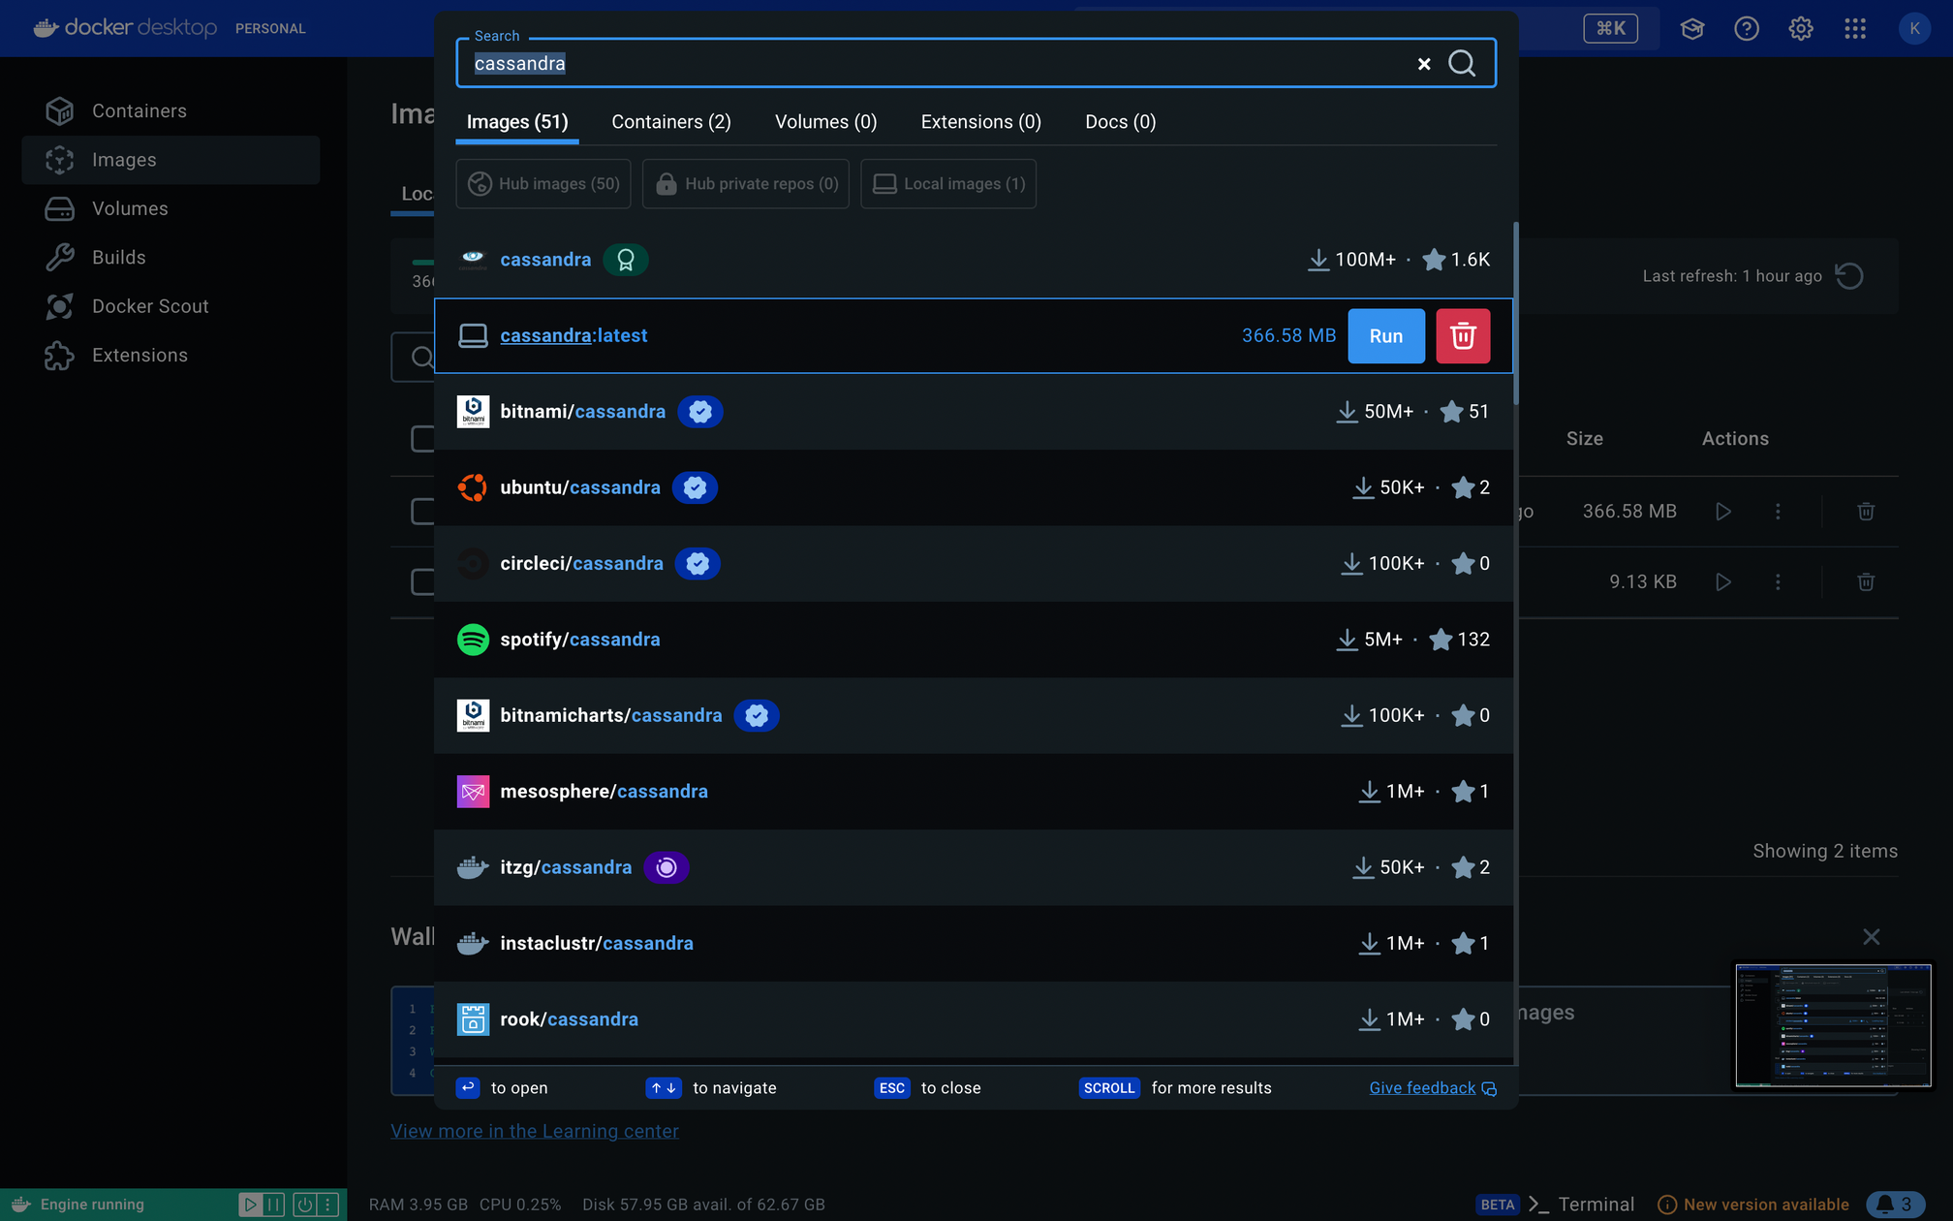
Installing using Docker Desktop

Slide 39
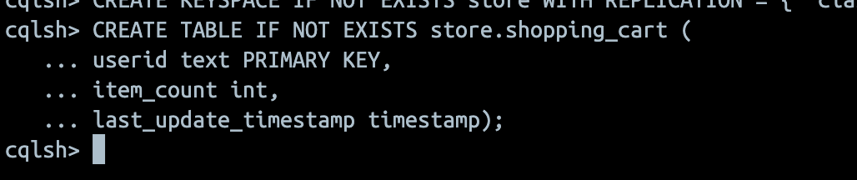
Using Cassandra (Functions & Queries)
-- Create a keyspace
CREATE KEYSPACE IF NOT EXISTS store WITH REPLICATION = { 'class' : 'SimpleStrategy', 'replication_factor' : '1' };
-- Create a table
CREATE TABLE IF NOT EXISTS store.shopping_cart (
userid text PRIMARY KEY,
item_count int,
last_update_timestamp timestamp);

Slide 40
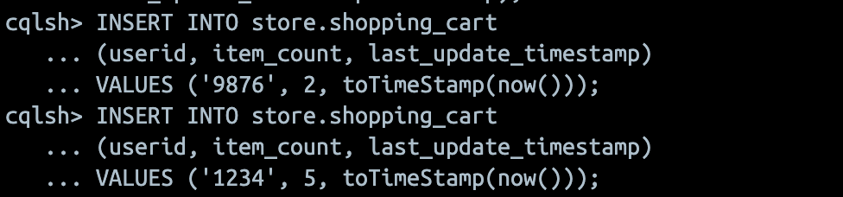
Using Cassandra (Functions & Queries)
-- Insert some data
INSERT INTO store.shopping_cart
(userid, item_count, last_update_timestamp)
VALUES ('9876', 2, toTimeStamp(now()));
INSERT INTO store.shopping_cart
(userid, item_count, last_update_timestamp)
VALUES ('1234', 5, toTimeStamp(now()));

Slide 41
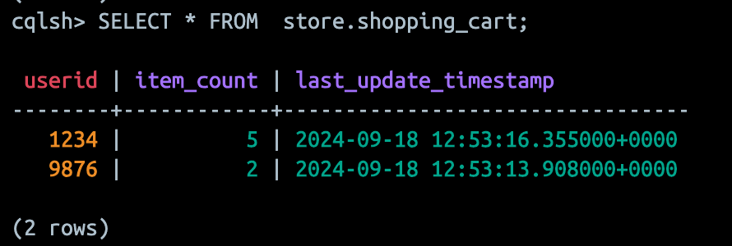
Using Cassandra (Functions & Queries)
-- Select data
SELECT * FROM store.shopping_cart;

Slide 42
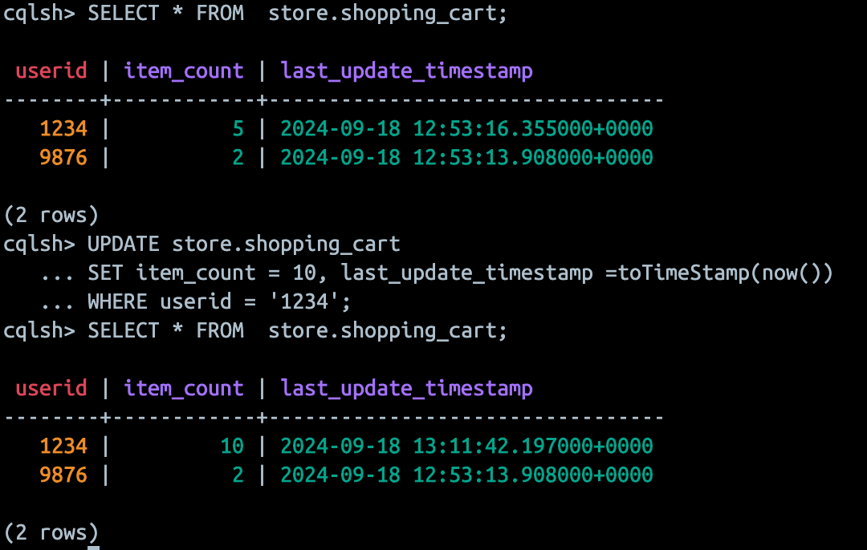
Using Cassandra (Functions & Queries)
-- Update an existing record
UPDATE store.shopping_cart
SET item_count = 10, last_update_timestamp =toTimeStamp(now())
WHERE userid = '5678';

Slide 43
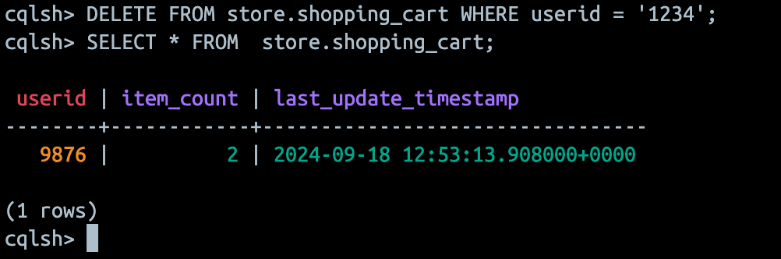
Using Cassandra (Functions & Queries)
-- Delete a record
DELETE FROM store.shopping_cart
WHERE userid = '1234';

Slide 44
Using Cassandra (Functions & Queries)
-- Drop a table if needed
DROP TABLE IF EXISTS store.shopping_cart;
-- Drop the keyspace
DROP KEYSPACE IF EXISTS store;

Slide 45


Using Cassandra (via Python script)
-- Benchmarking basic operations using Python script
Import necessary method from library:
from cassandra.cluster import Cluster
Connect to the Cassandra cluster:
cluster = Cluster(['127.0.0.1'])
session = cluster.connect('keyspace_name')
Then you create a table, read data from a CSV file and insert it into the table.
You can also create, read, update and delete data from the data base, using basic functions and queries

Slide 46
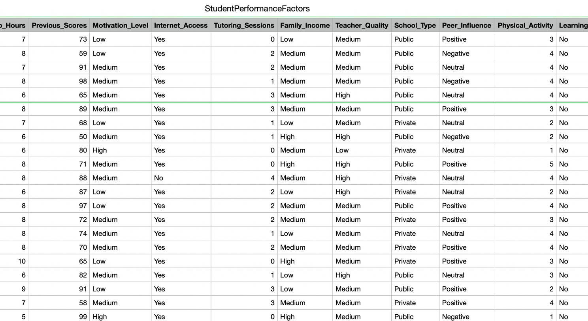

Experiment
Experimental data: Student Performance Factors
Number of Records: 6,607
Number of Features: 20
https://www.kaggle.com/datasets/lainguyn123/student-performance-factors

Slide 47
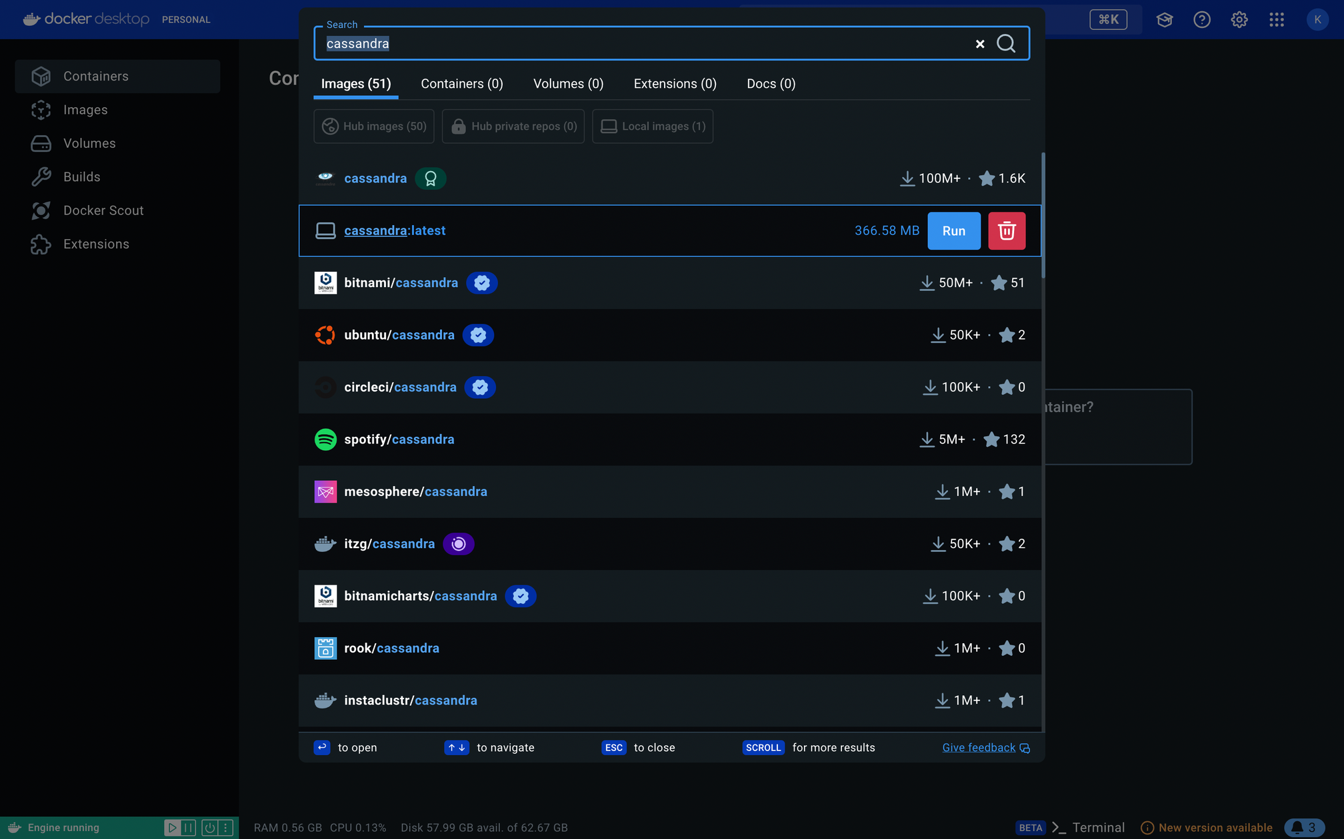
Run a Cassandra

Slide 48
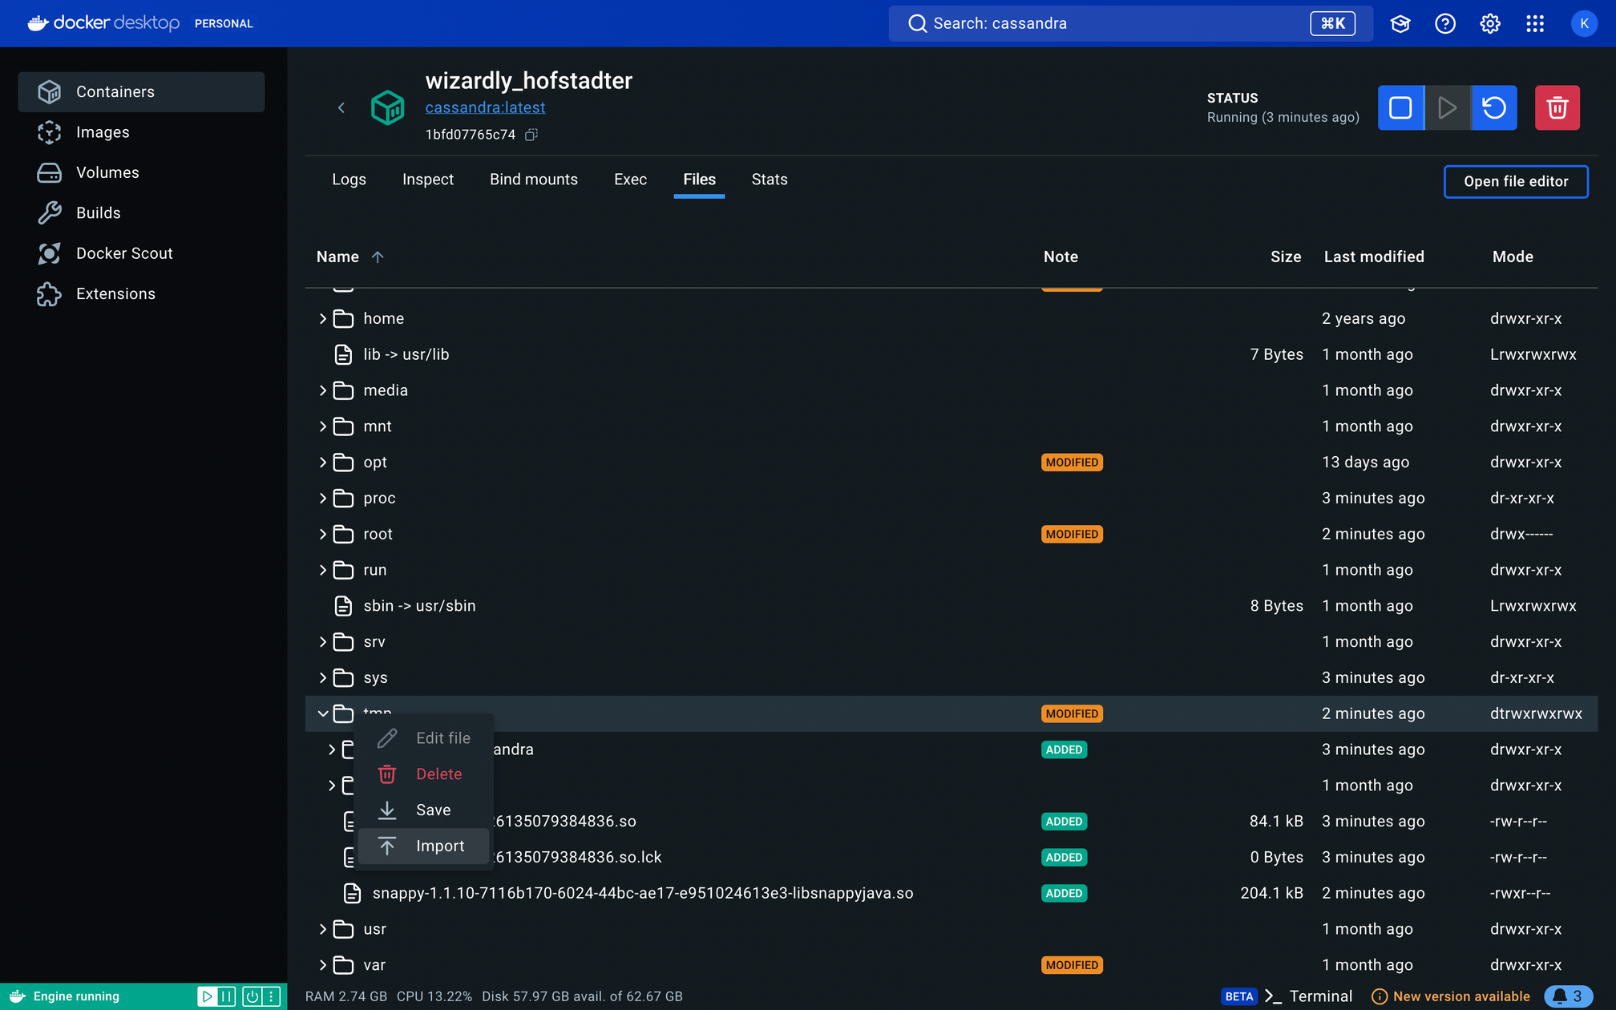
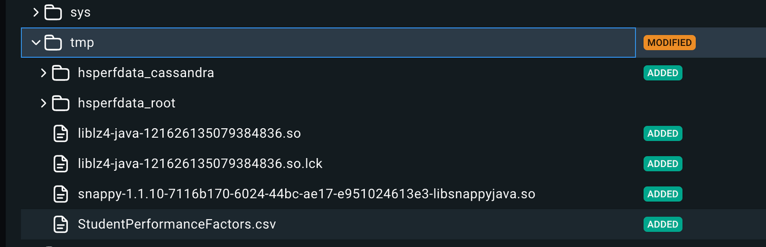
Import data from csv

Slide 49
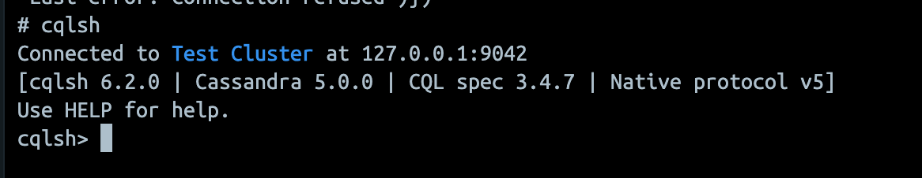
Run CQL shell

Slide 50
Create keyspace, table
CREATE KEYSPACE student_data WITH REPLICATION = { 'class' : 'SimpleStrategy', 'replication_factor' : 1 };
USE student_data;
CREATE TABLE student_performance (
hours_studied FLOAT,
attendance FLOAT,
parental_involvement TEXT,
access_to_resources TEXT,
extracurricular_activities TEXT,
sleep_hours FLOAT,
previous_scores FLOAT,
motivation_level TEXT,
internet_access TEXT,
tutoring_sessions FLOAT,
family_income TEXT,
teacher_quality TEXT,
school_type TEXT,
peer_influence TEXT,
physical_activity FLOAT,
learning_disabilities TEXT,
parental_education_level TEXT,
distance_from_home TEXT,
gender TEXT,
exam_score FLOAT,
PRIMARY KEY (hours_studied,attendance)
);

Slide 51
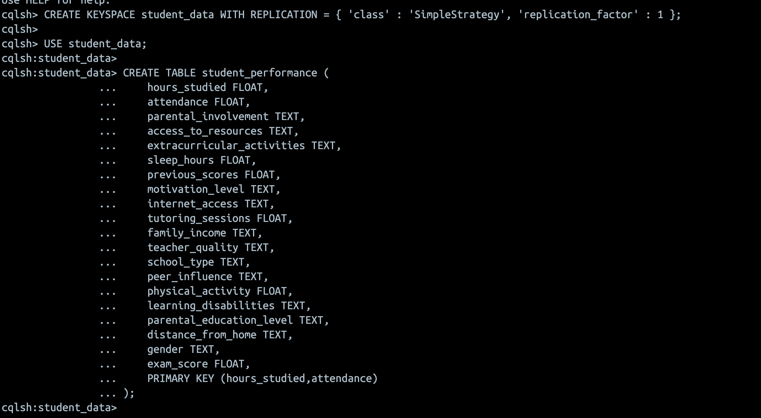
Create keyspace, table

Slide 52
Copy data from csv file
COPY student_performance (
hours_studied, attendance, parental_involvement, access_to_resources, extracurricular_activities, sleep_hours, previous_scores,
motivation_level, internet_access, tutoring_sessions, family_income, teacher_quality, school_type, peer_influence, physical_activity,
learning_disabilities, parental_education_level, distance_from_home, gender, exam_score
)
FROM '/tmp/StudentPerformanceFactors.csv'
WITH HEADER = TRUE;
SELECT statement
SELECT * FROM student_performance;

Slide 53
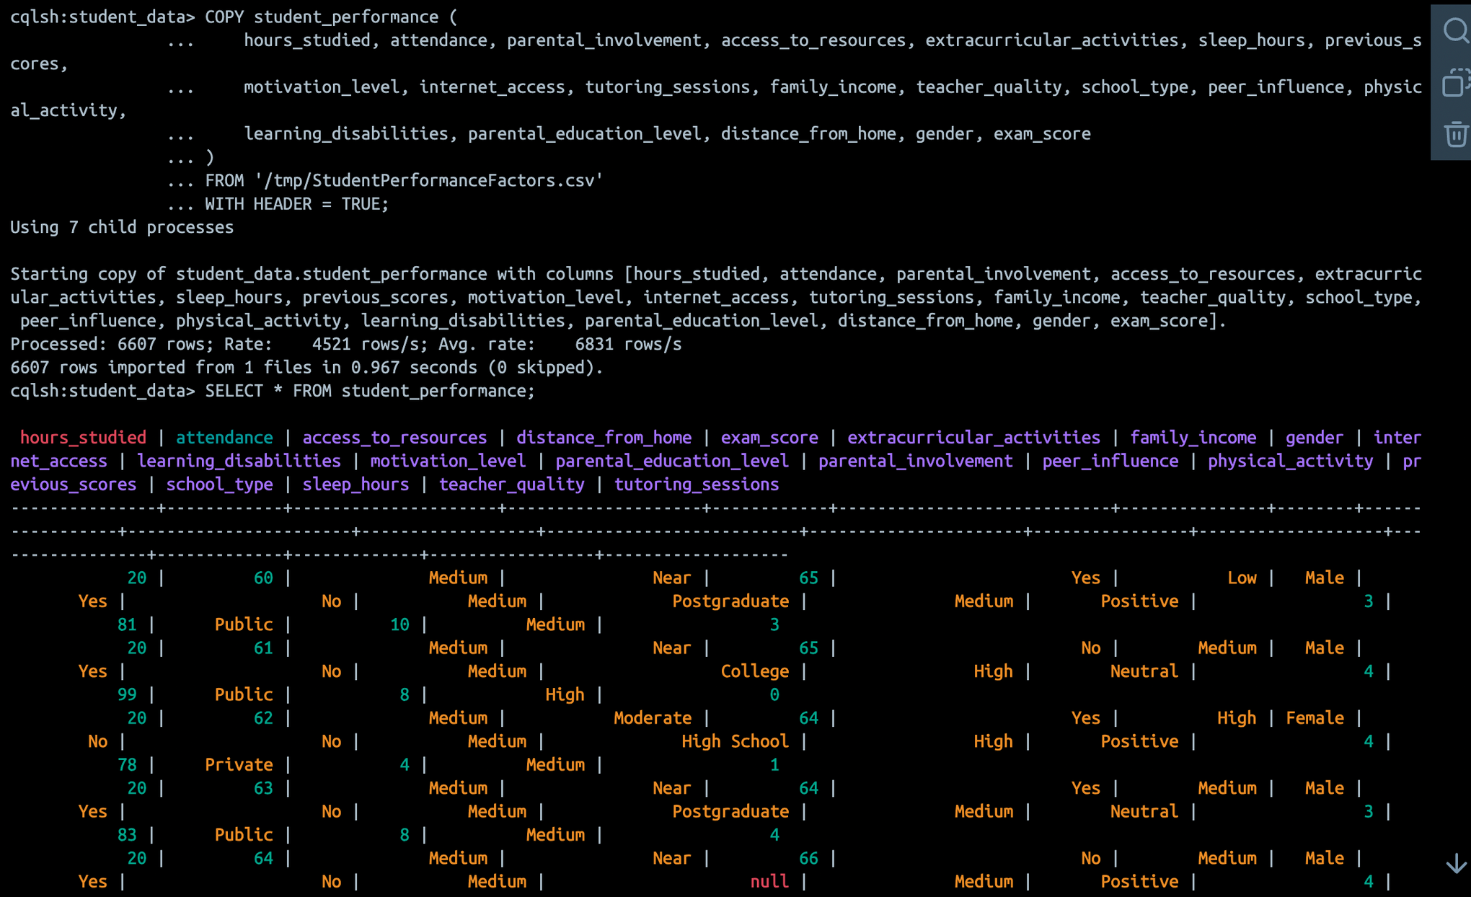
Copy data from csv file

Slide 54
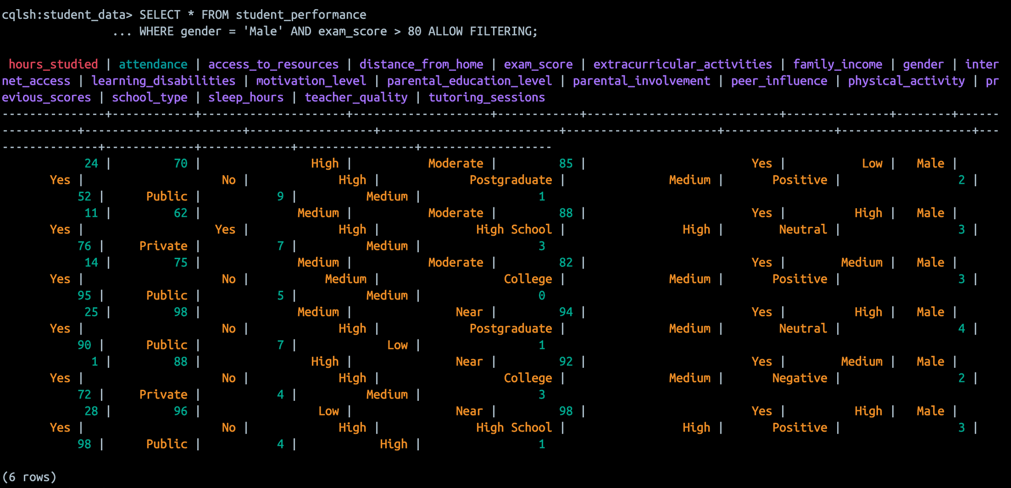
Complex Query
SELECT * FROM student_performance
WHERE gender = 'Male' AND exam_score > 80 ALLOW FILTERING;

Slide 55
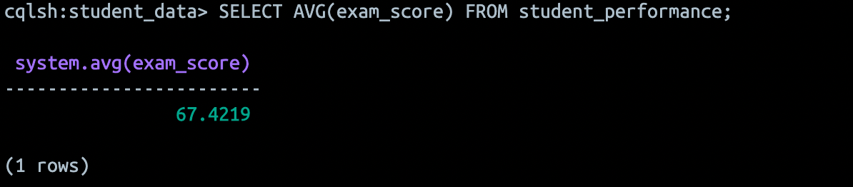
Search for average score
SELECT AVG(exam_score) FROM student_performance;
Average exam score is 67

Slide 56
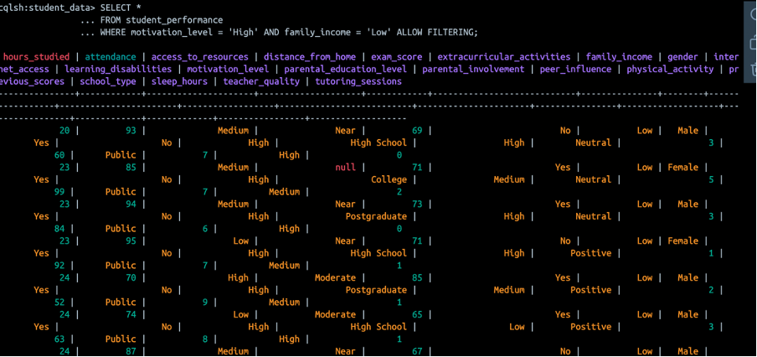
SELECT for High Motivation and Low Family Income
SELECT *
FROM student_performance
WHERE motivation_level = 'High' AND family_income = 'Low' ALLOW FILTERING;

Slide 57
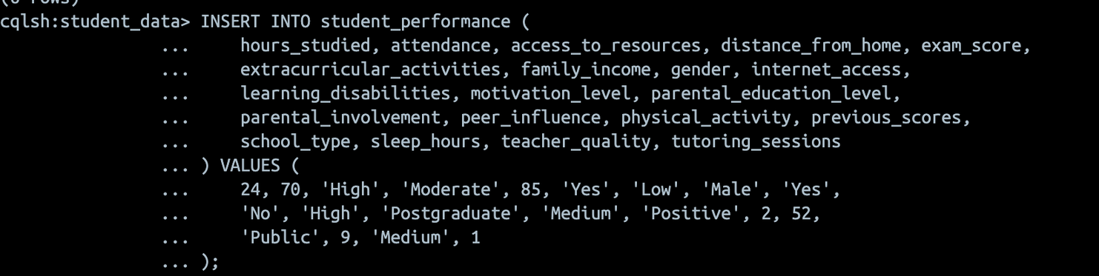
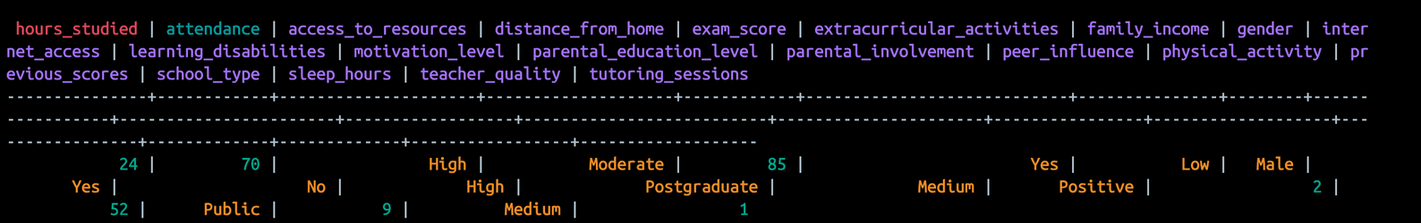
Insert operation
INSERT INTO student_performance ( hours_studied, attendance, access_to_resources, distance_from_home, exam_score, extracurricular_activities, family_income, gender, internet_access, learning_disabilities, motivation_level, parental_education_level, parental_involvement, peer_influence, physical_activity, previous_scores, school_type, sleep_hours, teacher_quality, tutoring_sessions ) VALUES ( 24, 70, 'High', 'Moderate', 85, 'Yes', 'Low', 'Male', 'Yes', 'No', 'High', 'Postgraduate', 'Medium', 'Positive', 2, 52, 'Public', 9, 'Medium', 1 );
SELECT * FROM student_performance
WHERE gender = 'Male' AND exam_score = 85 ALLOW FILTERING;

Slide 58
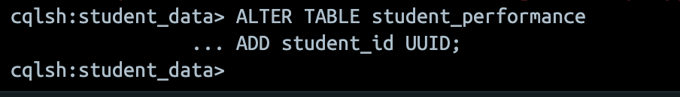
Update the table colums
ALTER TABLE student_performance
ADD student_id UUID;
Delete from the table

Slide 59

Thank You!
If you have questions, feel free to ask

